Slide 1
CTMS KC Successes and Challenges
Mohammad Farid
Cross KC
March 2009

Slide 2
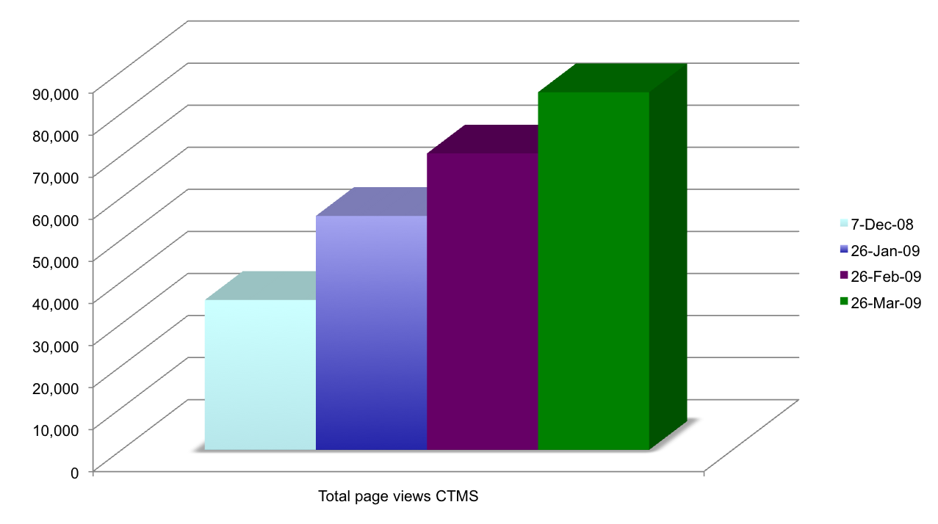
CTMS KC Users
A large user base to support
Indicators suggest growing interest in CTMS Knowledge Center

Slide 3
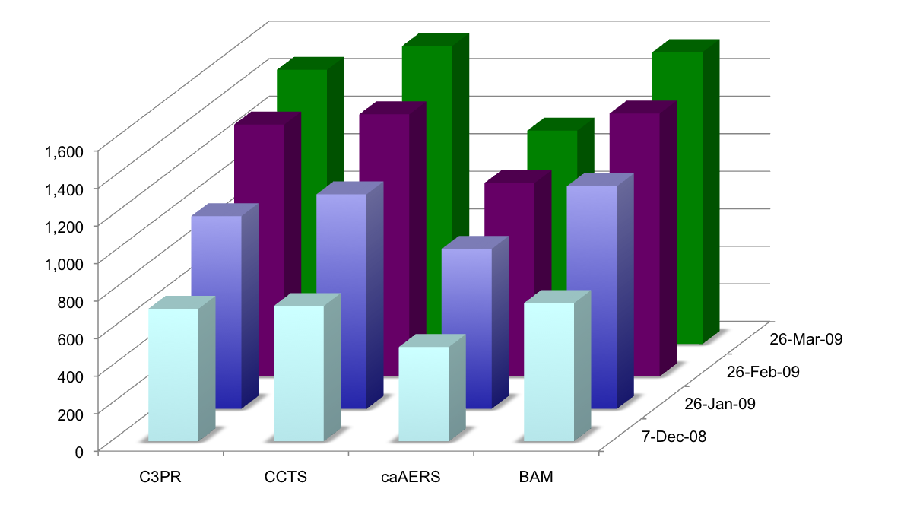
CTMS KC Application Page Views
Proportional growth of individual application inquires
More sensitive measures are needed

Slide 4
CTMS KC Applications
Currently there are total of 6 applications we support on our KC
  caAERS – Adverse Event Reporting
  C3PR - Patient Registry
  PSC – Patient Study Calendar
  LabViewer
  C3D Connector
  caXchange
CCTS is a bundle which includes all these tools, currently at version 1.1
We will be supporting multiple versions of the tools which will include
  Application Release
  Documentation
  Patches and bug fixes

Slide 5
CTMS KC Tech Stack
Forums
There are a total of 15 forum topics that we are currently monitoring
General Discussion
Two for each tool, End Users and Developer
Two for Announcements
Forums are monitored by Operations Manager, Technical Manager, Developers and Subject Matter Experts
There have been requests for special interest forums e.g. CDL’s
There has been an evolution in the nature of questions posted on the forum

Slide 6
Forum Examples and Evolution
About the CTMS KC Forums
The CTMS Knowledge Center forums are used to post questions about anything related to the caBIG CTMS software products or the Knowledge Center…
Oracle space requirements?
We would like to install stand alone caAERS for evaluation.
I understand that the minimum memory requirements are 2 GB RAM and 36 GB Disk Space. How much of the disk space do folks set aside for the Oracle database?
Posting Clinical Trial Data on the Grid
Greetings,
I have a few questions about posting clinical trial data on the grid…
Data Sharing…HIPAA…grid…
Aug
Sep
Oct
Nov
Dec
Jan
Feb
Mar
Feedback: September 8-9 CTMS Face to Face
WELCOME to a discussion using the CTMS Knowledge Center wiki on the September 8 and 9 CTMS Face to Face meeting at St. Jude Children's Research Center in Memphis, TN.
Summary 3 Reports & anatomic sites
…Why do C3PR and the NCI's requirements for the Summary reports differ? Are the NCI's disease sites just examples, not requirements, or is this list antiquated and likely to change shortly to be more like what is currently in C3PR?...

Slide 7
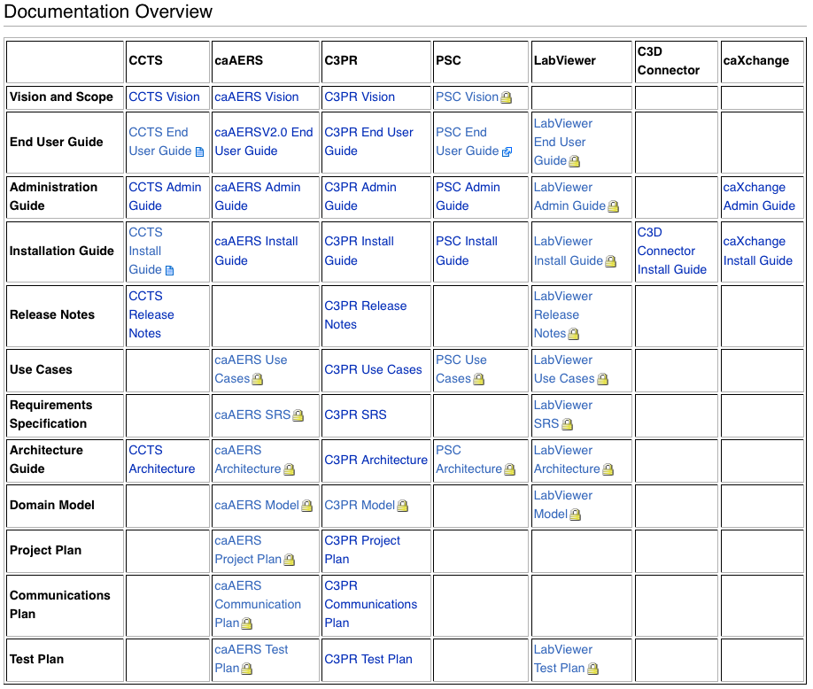
CTMS KC Documentation
We have provided the documentation for different tools on the Wiki
We have a total of 47 different documents for various applications available on Wiki, these include
CCTS – 6
caAERS – 11
C3PR – 12
PSC – 6
LabViewer – 9
C3D Connector – 1
caXchange - 2

Slide 8
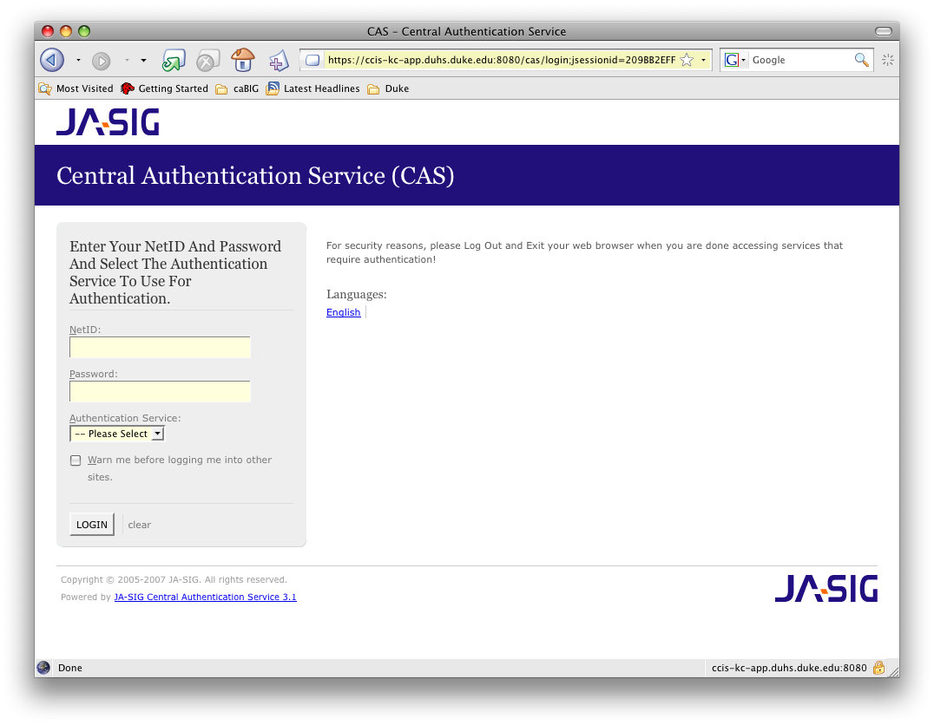
CTMS KC Demo
We provide a public demo site for all applications and CCTS 1.1 bundle at http://ccis-kc-app.duhs.duke.edu/c3pr
Username: cctsdemo1@nci.nih.gov
Password: Ccts_admin123!

Slide 9
CTMS KC Outreach Effort
Presented and scheduled to present at various meetings and conferences, to name a few
AMIA – Translational Informatics
Society for Clinical Trials
Bio-IT World
ASCO
As a result we have been contacted by various groups and companies
Rapid Pharmaceuticals
Dental Practice based Research Network (PBRN)
Organized and provide support demonstration at with different groups within caBIG and outside caBIG
Walter Reed Army Medical Center
Different workspaces and conferences.

Slide 10
CTMS KC Adoption Help
Assisted a large number of organization through email and forums
Hands-on help extended by Knowledge Center to different adopters with installation and bug fixes
Bill Dyer – CCTS installation incl. C3D connector and Loading Labs
Ken Quinn (Roswell Park) – caAERS
Rick Sanchegraw (Health. Missouri) – caAERS
Farid Mohammad (Duke) - C3PR, caAERS
Amish Shah (CALGB) – caAERS
Bob - caAERS

Slide 11
CTMS KC Challenges
Building a critical mass of users
Organize various application versions on the Wiki
  Currently varies with each tools
  Frequency and release numbers are not consistent
Fielding requests from various channels and track them centrally using a tracking system
Prepare and provide training material for the trainer
Include code contributions from adopters to new application releases
Establish best practices for
  Responding to issues
  Working on bug fixes and patches
  Creating FAQ’s
  Updating documentation
  Closing issues and collecting feedback

Slide 12
Questions and Answers

